Slide 1
PROBLEM SOLVING AND PROGRAMMING USING PYTHON
Mr.Panduraju Pagidimalla
Assistant Professor, Dept of AIML

Slide 2
Unit-I: Software requirements for programming

Slide 3
Operating System

Slide 4
What is an Operating System (1)?
A modern computer consists of:
  One or more processors
  Main memory
  Disks
  Printers
  Various input/output devices.
Managing all these varied components requires a layer of software – the
Operating System (OS).

Slide 6
What is an Operating System (2)?
An Operating System is a program that acts as an intermediary/interface between a user of a computer and the computer hardware.
OS goals:
  Control/execute user/application programs.
  Make the computer system convenient to use.
  Ease the solving of user problems.
  Use the computer hardware in an efficient manner.

Slide 7
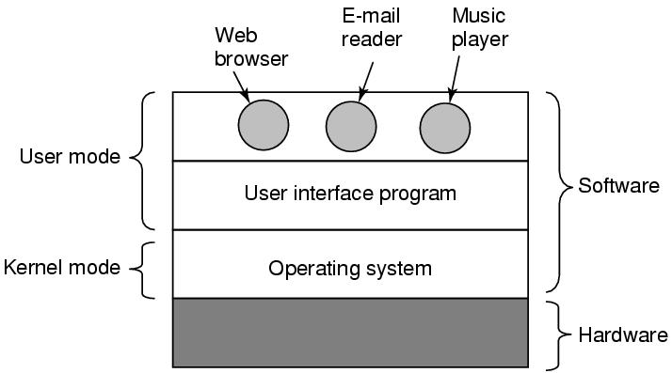
Where does the OS fit in?

Slide 8
Services provided by an OS
Facilities for program creation
  editors, compilers, linkers, debuggers, etc.
Program execution
  loading in memory, I/O and file initialization.
Access to I/O and files
  deals with the specifics of I/O and file formats.
System access
  resolves conflicts for resource contention.
  protection in access to resources and data.

Slide 9
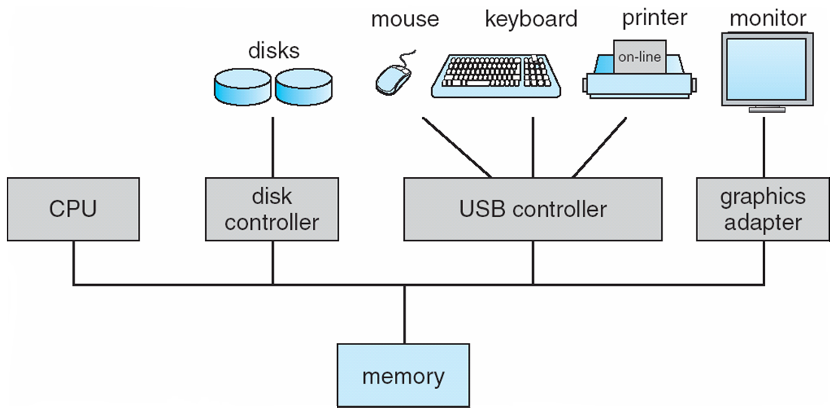
Computer Hardware Organization

Slide 10
Computer System

Slide 11
Computer System Components
Hardware – provides basic computing resources (CPU, Memory, I/O devices, Communication).
Operating System – controls and coordinates
use of the hardware among various application programs for various users.
System & Application Programs – ways in which the system resources are used to solve computing problems of the users (Word processors, Compilers, Web browsers, Database systems, Video games).
Users – (People, Machines, other computers).

Slide 12
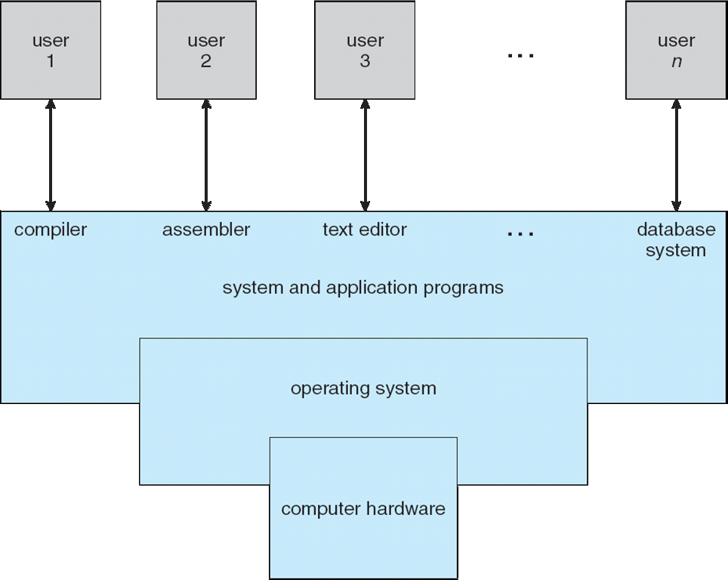
Static View of System Components

Slide 13
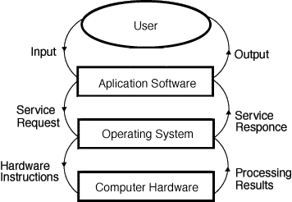
Dynamic View of System Components

Slide 14
Layers of a Computer System
End
User
Programmer
Application
Programs
Utilities
Operating-
System
Designer
Operating-System
Computer Hardware

Slide 15
THANK YOU !

